Slide 1
Mobile Programming
Term Project Progress Report

Slide 2
Title
Index
Team members
Title
Team members
Brief description
Contents
Key features
Technologies
Implementation
8. What each member did
9. Timeline
10. Wiki page
Brief description
contents
Key features
Technologies

Slide 3
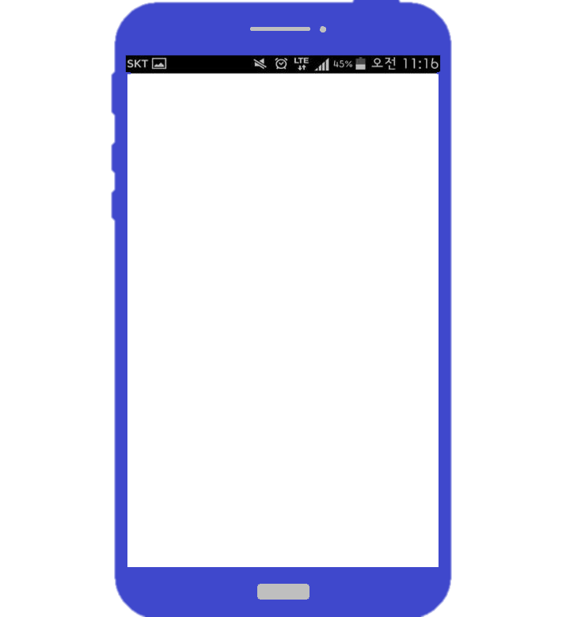

Title
Team members
Brief description
CloseT: 당신의 옷장에 가까이
Clothes Management & Stylist Recommendation App
contents
CloseT
Key features
Technologies

Slide 4
Title
★★★★★
★★★★★
MEMBER
MEMBER
Team members
Name : 유정재
Student ID : 201533655
E-mail Address : yy5538012@naver.com
Name : 임홍재
Student ID : 201533665
E-mail Address : iihhjj2002@naver.com
Brief description
★★★★★
★★★★★
contents
MEMBER
MEMBER
Name : 김준호
Student ID : 201635807
E-mail Address : inpie212@gmail.com
Name : 이철순
Student ID : 201635842
E-mail Address : chirsoon@naver.com
Key features
Technologies

Slide 5
Title
Team members
“
Brief description
Do you exactly remember what clothes are in your closet?
With ‘CloseT’, you can check what clothes you have,
find the best dress code by matching clothes one by one any time.
Don’t you spend too much time deciding what to wear in every morning?
”
contents
Key features
Technologies

Slide 6
Title
Cloth management
d
Team members
Clothes Registration
1) Taking pictures of your clothes and registering them.
2) Entering information about clothes when registering them. (ex. type, color, brand, price, proper situation..)
Clothes List
Displaying registered clothes as a list by categories based on information about clothes.
Clothes Removal
1) Removing clothes from a closet, if clothes are thrown away or lost.
Brief description
contents
Key features
Simultaneous read and write are possible
using Real Time Database (Firebase)
Technologies

Slide 7
Title
Cody
d
Team members
Clothes matching
1) Displaying registered clothes as a list by categories based on information about clothes.
2) Matching clothes on a user model. (with the user’s face)
Brief description
Cody list
1) After creating the cody, you can save it to the cody list and view it anytime.
contents
3. Support shopping
1) If you screenshot and store the clothes you want to buy before buying clothes,
you can check if they match well with your existing clothes by matching them with
the clothes you already have.
Key features
Technologies

Slide 8
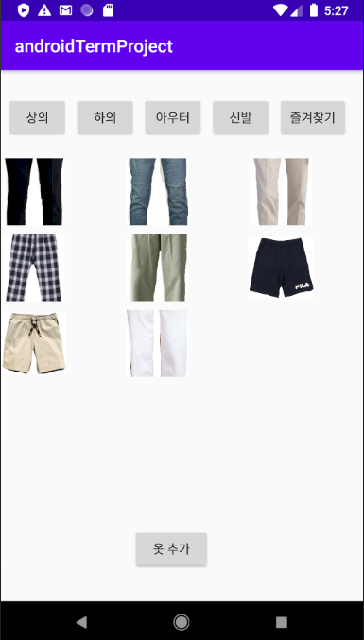
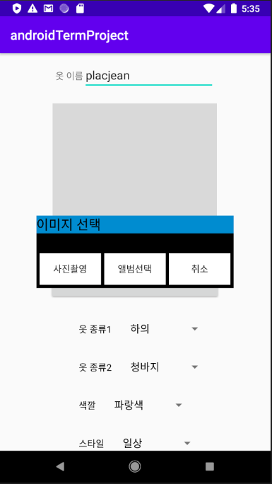
Title
Check Point
Team members
Clothes
d
CloseT
CloseT
Category
Category
Displaying registered clothes as a list by categories based on information about clothes.
There are two functions for adding clothes photos : taking with the camera or uploading from album
*(Taking with the camera) : since the data is
saved as a file, it is imported as the original
image, not as a thumbnail image
Brief description
상의
하의
신발
상의
하의
신발
Color
Color
검정
흰색
파랑
검정
흰색
파랑
contents
초록
노랑
빨강
초록
노랑
빨강
Style
Style
격식
일상
운동
격식
일상
운동
Key features
완료
초기화
완료
초기화
Technologies

Slide 9
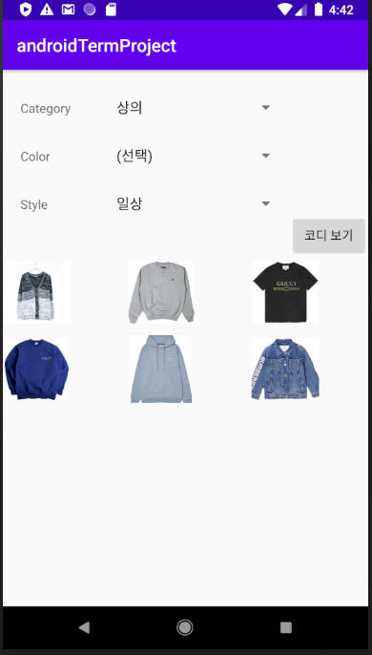
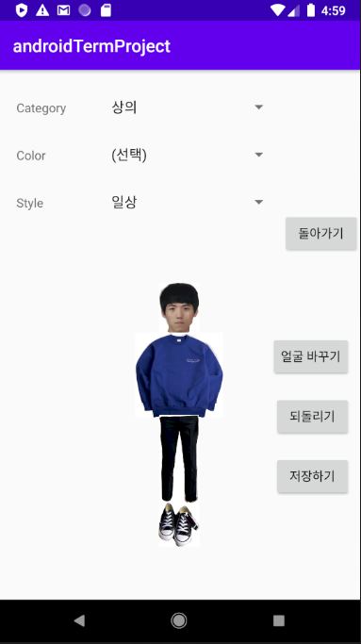
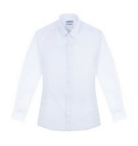
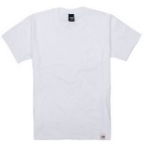

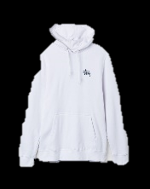
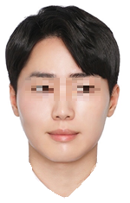

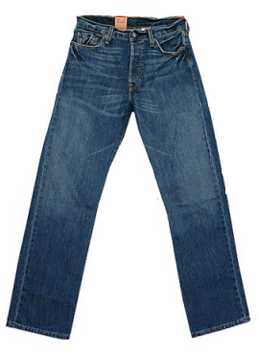
Title
Check Point
Team members
Cody
CloseT
CloseT
d
상의
상의
1) Finding the best dress code by matching
clothes on a user model.
2) Finished cody can be saved in cody list.
3) User’s face can be changed.
Brief description
Color :
흰색
Color :
흰색
Style :
Style :
일상
일상
contents
<예상 이미지>
<예상 이미지>
완료
초기화
완료
초기화
Key features
Technologies

Slide 10
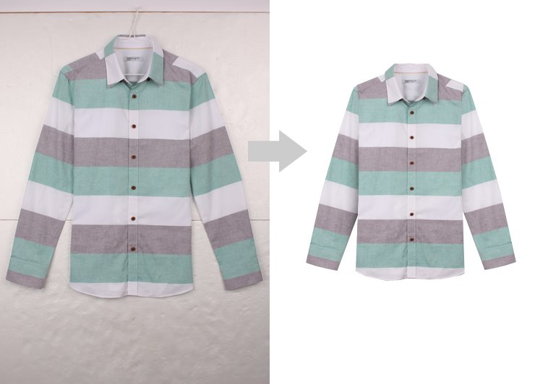
Title
Check Point
Team members
Difference with an existing application
d
Brief description
Ability to remove background from a picture
and extract only a clothing image.
(Grabcut Algorithm)
contents
Key features
Technologies

Slide 11
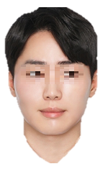
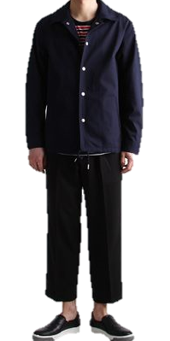
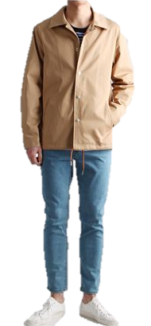
Title
Check Point
Team members
Difference with an existing application
d
Brief description
You can match your clothes directly to
customized modeling image.
(with user face)
contents
Key features
Technologies

Slide 12


Title
d
Team members
Brief description
Firebase includes real-time database on the network
provided by Google Cloud Platform.
contents
Firebase
Key features
Technologies

Slide 13

Title
d
Team members
Brief description
Grab cut is an auto photo cutting software.
It doesn’t need selection, marking persons,
and any input required.
contents
Grab cut
Key features
Technologies

Slide 14

Title
d
Team members
Brief description
Functions that import photo from camera(original data) or album, and leftover functions
contents
Others
Key features
Technologies

Slide 15

Title
d
Team members
Brief description
Android GUI is the graphical and usually touch-sensitive display on a mobile device, such as a smartphone or tablet, that allows the user to interact with the device’s apps, features, content and functions.
contents
Android GUI
Key features
Technologies

Slide 16
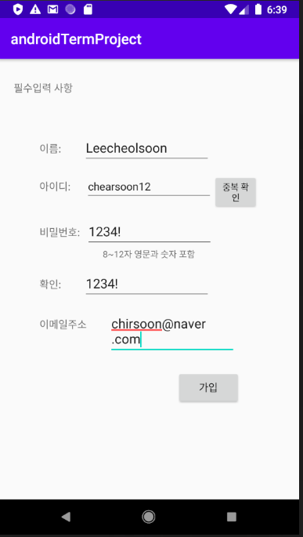
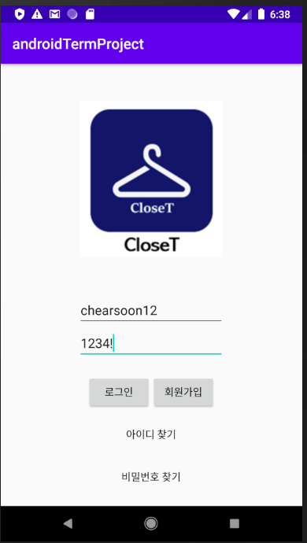
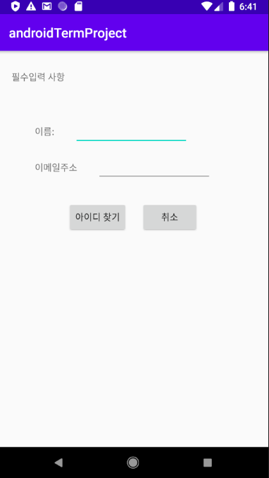
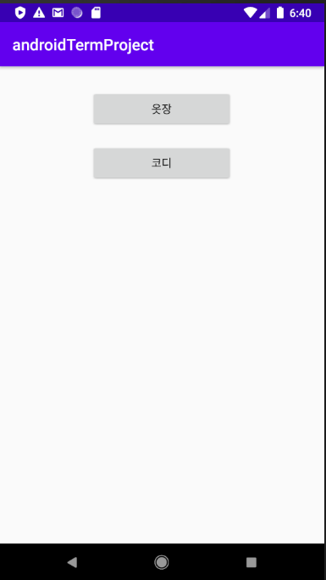
Implementation
Membership
Member did
Timeline
Wiki page
Sign-up
Login
Find id/pw
Select category

Slide 17
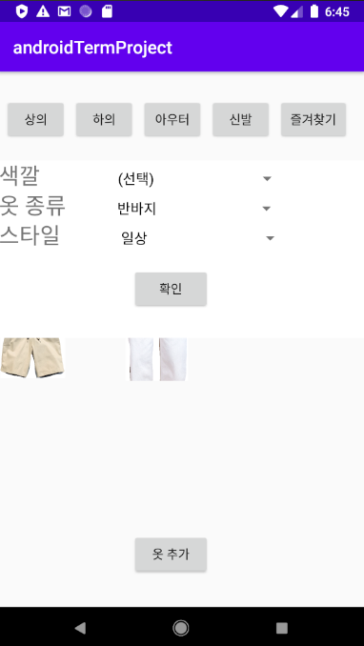

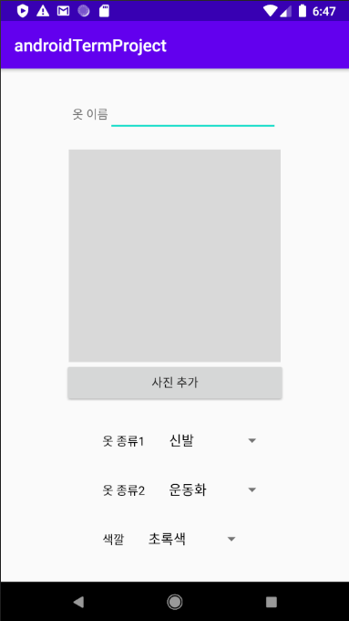
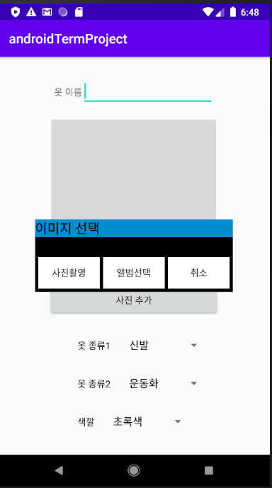
Implementation
Clothes Management
Member did
Timeline
Wiki page
Select information
List
Add cloth
Add picture

Slide 18
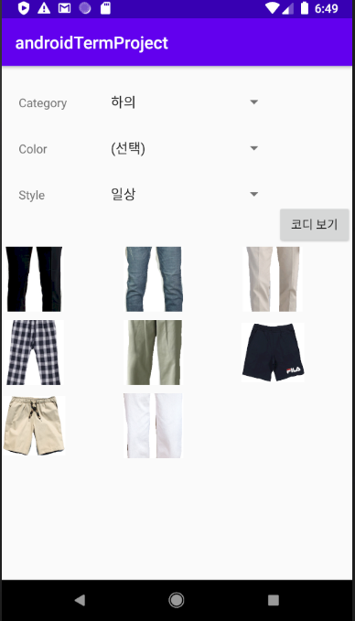
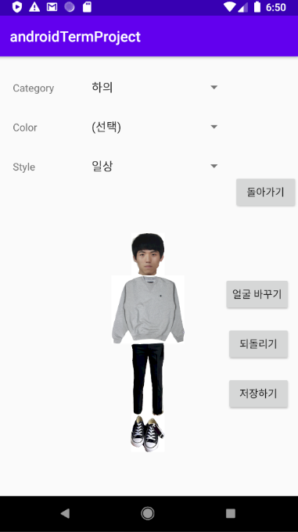
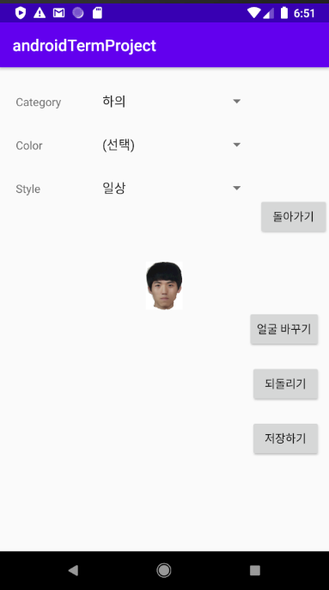
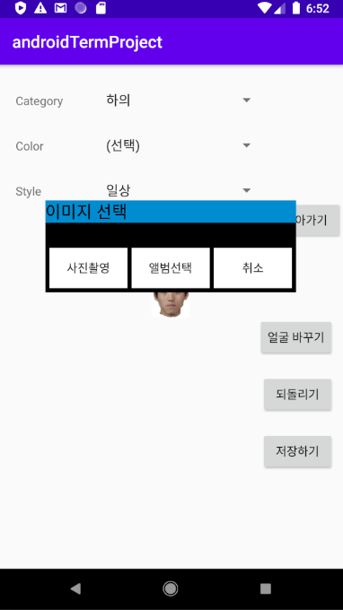
Implementation
Cody
Member did
Timeline
Wiki page
Cloth list
Model
Reset
Change face

Slide 19
Implementation
유정재
임홍재
김준호
이철순
<Joint Part>
Coding of xml file
and java file.
<Joint Part>
Coding of xml file and java file.
<Joint Part>
Coding of xml file and java file.
<Joint Part>
Coding of xml file and java file.
Member did
Timeline
<Individual Part>
Firebase construction and integration
(all parts of database)
<Individual Part>
Implementation of image processing.
(grab cut)
<Individual Part>
All design parts
Manage wiki page
Proposal ppt
<Individual Part>
Picture upload
model function
Connect all activities
Progress ppt
Wiki page

Slide 20
Implementation
Schedule
Member did
< April >
SUN | MON | TUE | WED | THU | FRI | SAT
 |  |  | 1 | 2 | 3 | 4
5 | 6 | 7 | 8 | 9 | 10 | 11
12 | 13 | 14 | 15 | 16 | 17 | 18
19 | 20 | 21 | 22 | 23 | 24 | 25
26 | 27 | 28 | 29 | 30 | 1
Creating team
Selecting subject
Timeline
Creating wiki page
Making and presenting proposal presentation
Wiki page

Slide 21
Implementation
Schedule
Member did
< May >
SUN | MON | TUE | WED | THU | FRI | SAT
 |  |  |  |  | 1 | 2
3 | 4 | 5 | 6 | 7 | 8 | 9
10 | 11 | 12 | 13 | 14 | 15 | 16
17 | 18 | 19 | 20 | 21 | 22 | 23
24 | 25 | 26 | 27 | 28 | 29 | 30
31
Making XML files
Studying image processing tool
Timeline
Continuing Making XML files
Making login java file
Studying image processing tool
Wiki page
Constructing firebase(DBMS)
Connecting firebase with java files
Making closet, cody java files
Implementing image processing tool

Slide 22
Implementation
Schedule
Member did
< June >
SUN | MON | TUE | WED | THU | FRI | SAT
 | 1 | 2 | 3 | 4 | 5 | 6
7 | 8 | 9 | 10 | 11 | 12 | 13
14 | 15 | 16 | 17 | 18 | 19 | 20
21 | 22 | 23 | 24 | 25 | 26 | 27
28 | 29 | 30 | 1 | 2
Implementing image processing tool
Connecting firebase with java files
Designing XML files
Making progress presentation
Timeline
Designing XML files
Debugging & Testing
Wiki page
Preparing final presentation
Finishing wiki page

Slide 23
Implementation
Schedule
Member did
< July >
SUN | MON | TUE | WED | THU | FRI | SAT
 |  |  | 1 | 2 | 3 | 4
5 | 6 | 7 | 8 | 9 | 10 | 11
12 | 13 | 14 | 15 | 16 | 17 | 18
19 | 20 | 21 | 22 | 23 | 24 | 25
26 | 27 | 28 | 29 | 30 | 31
Final presentation
Timeline
Wiki page

Slide 24
Implementation
Member did
Timeline
URL:
https://github.com/KimJunho97/Mobile_Programming_Term_Project
Wiki page

Slide 25
Thank you

